Slide 1
SEMESTER PROJECT
Name: RAFIA and FATIMA ZAHRA.
Roll NO: 110804 & 110803.

Slide 2
Restaurant POS with kitchen queue and ingredients usage

Slide 3
ENTITIES:
Customer
Order
Waiter
Kitchen queue
Menu items
Recipe
Ingredients
stock

Slide 4
Attribute:
Order: order_Id, waiter_id, order time, status, total amount.
Menu item: item_id, name, price.
Ingredients: ingredients_id, name, unit.
Stock: stock_id, ingredient_id,quantity.
Waiter: waiter_id, name.
Customer: customer_id, name, ph_no.
Recipe: recipe_id, item_id, name.
Kitchen queue: KQ_id, order_id, preparation priority, staus.

Slide 5
Tables:
Customer (Customer_ID [PK], customer_ Name, Phone).
Order (Order_ID [PK], Date, Time, Customer_ID [FK]).
Waiter (Waiter_ID [PK],waiter_ Name, Order_ID[PK], Phone).
Kitchen Queue (Queue_ID [PK], Order_ID [FK],preparation priority).
Menu_Items (Item_ID [PK],item_Name, Price).
Recipe (Recipe_ID [PK], Name, item-id[FK], Method).
Ingredient (Ingredient_ID [PK],ingredient_ Name, Recipe_ID [Fk], Unit, ingredient_Cost).
Stock (Stock_ID [PK], Quantity, Ingredient_ID [FK]).

Slide 6
NORMALIZATIONS:
1NF: as all the values appear atomic and there are no repaeating groups do its is already in 1 normal form.
2NF: as there is no partial dependency between these tables so it is in 2 normal form.
3NF:no transistive dependency exist between these entities so it is in 3 normal form.

Slide 7
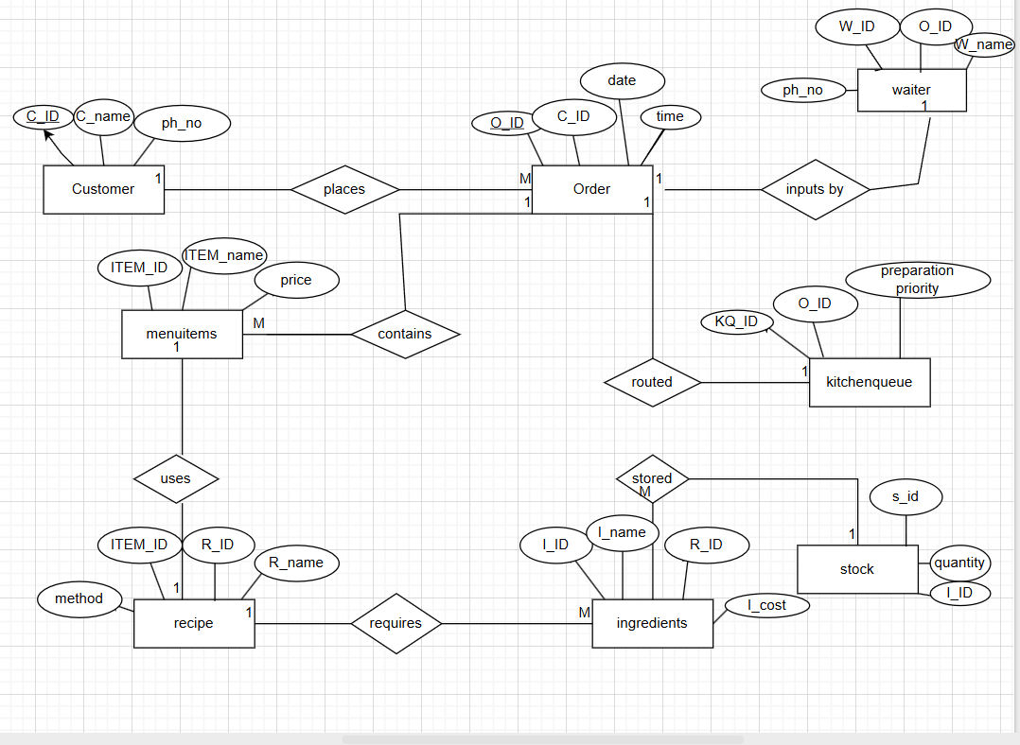
ER_DIAGRAM:

Slide 8
COMMON COMMANDS:
Show databases.
Use databases database_name.
CREATE TABLE table_name.
INSERT INTO table_name.
UPDATE table_name ,SET column1 = value1, column2 = value2,
...WHERE condition;
DELETE FROM table_name,WHERE condition;
Alter table table_name ADD attribute_name type(domain).
Show tables.
Describe tables table_name.

Slide 9
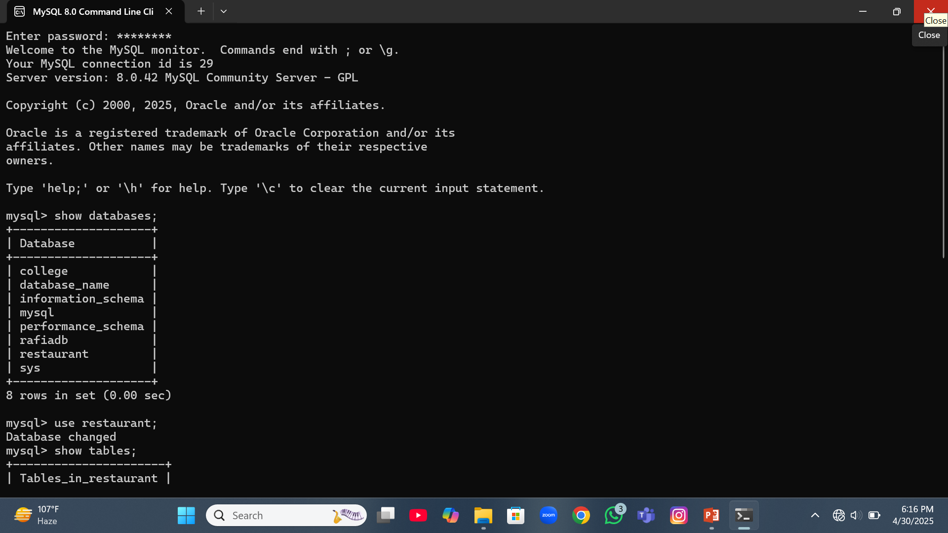
DATABASE:

Slide 10
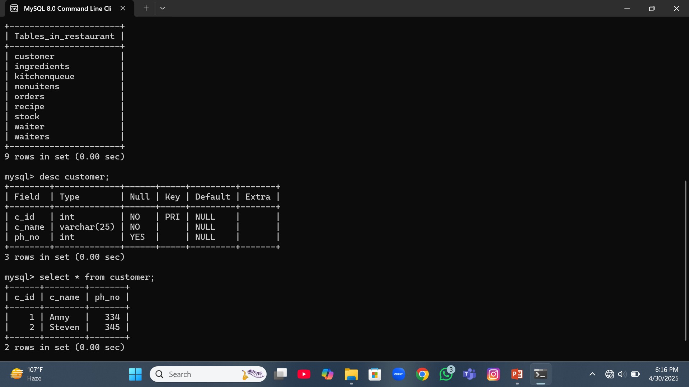

Slide 11
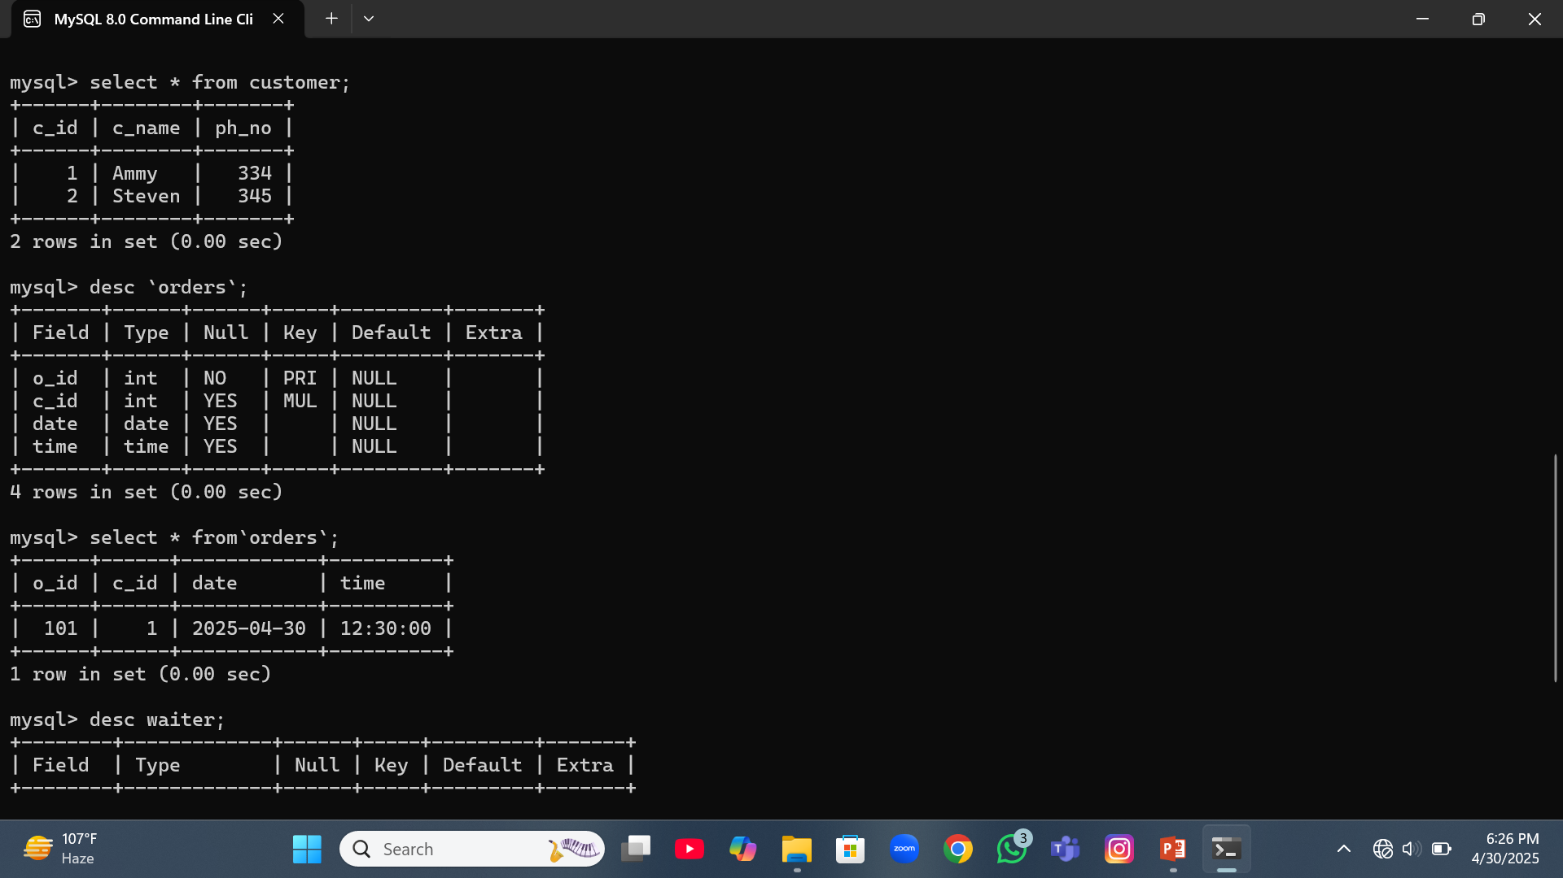

Slide 12
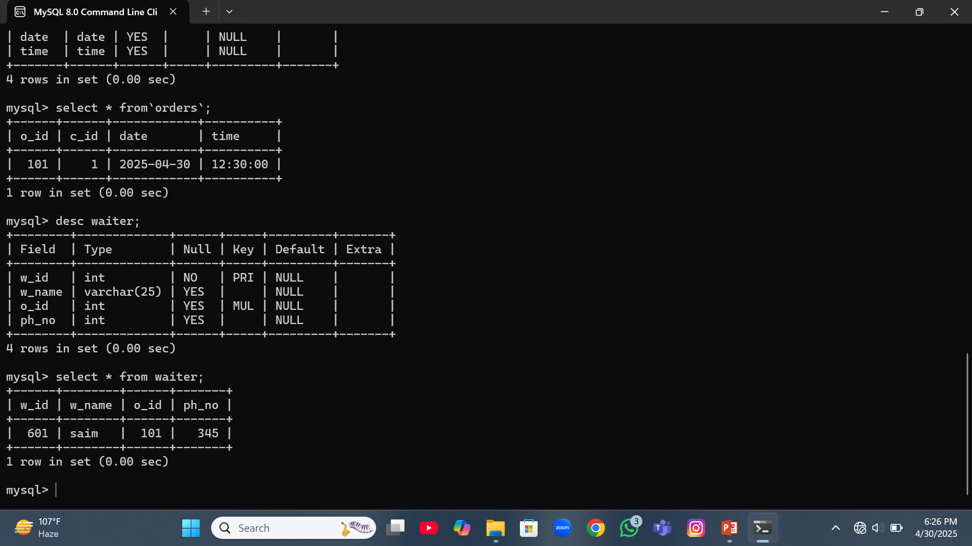

Slide 13
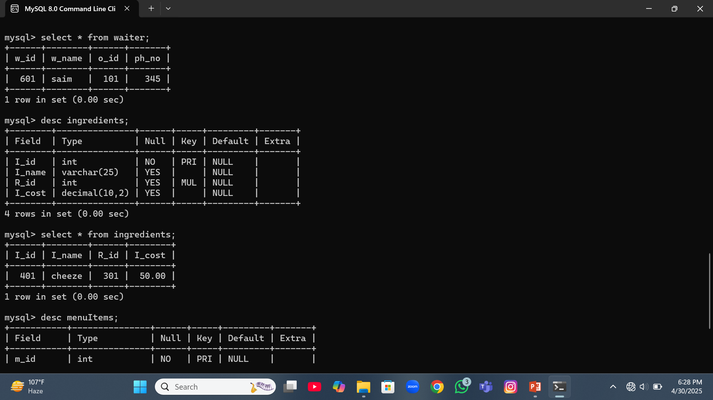

Slide 14
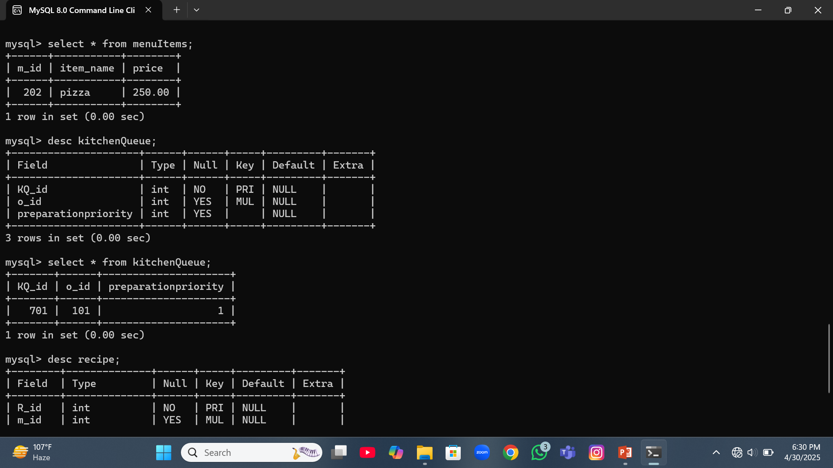

Slide 15
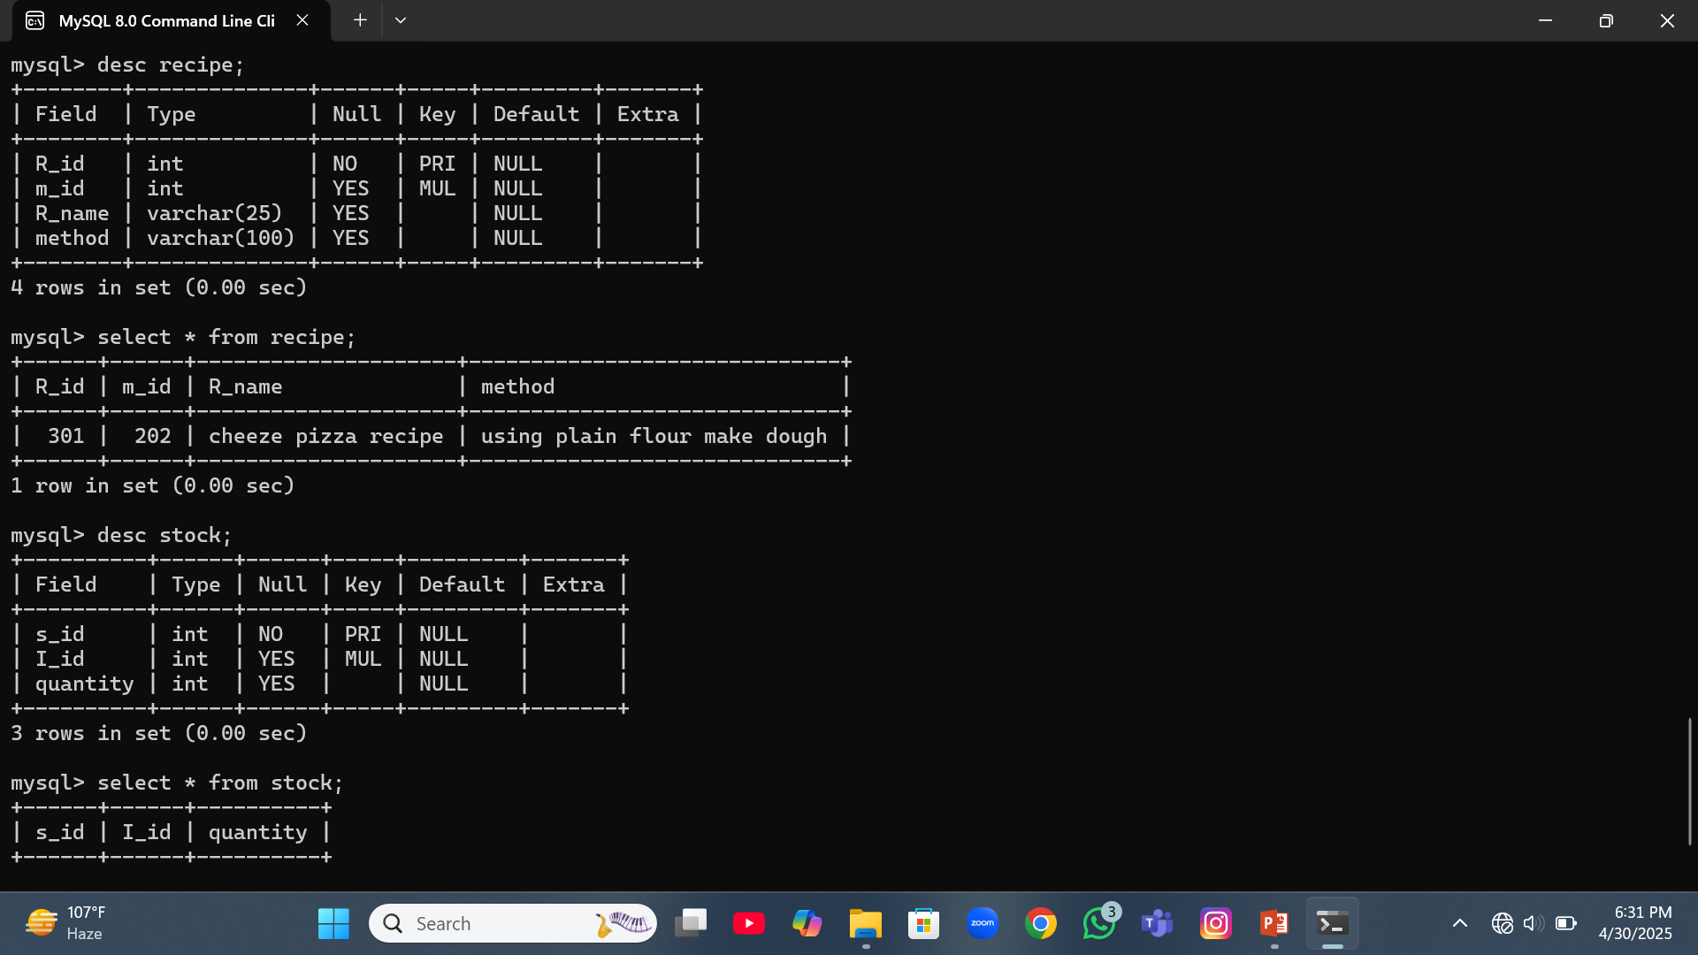

Slide 16
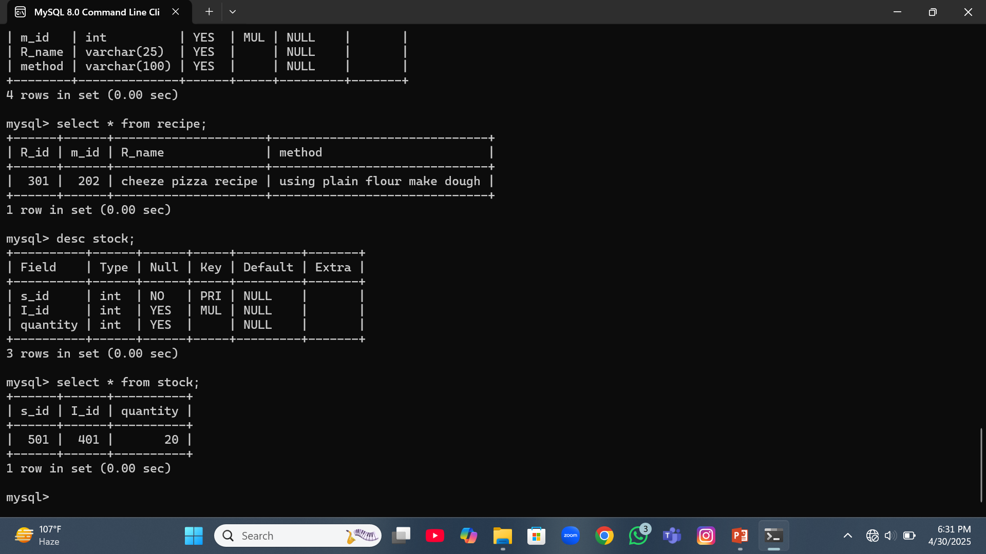

Slide 17
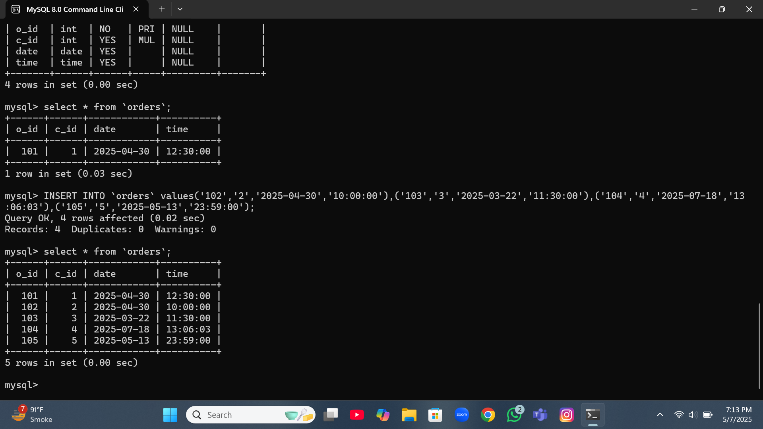

Slide 18
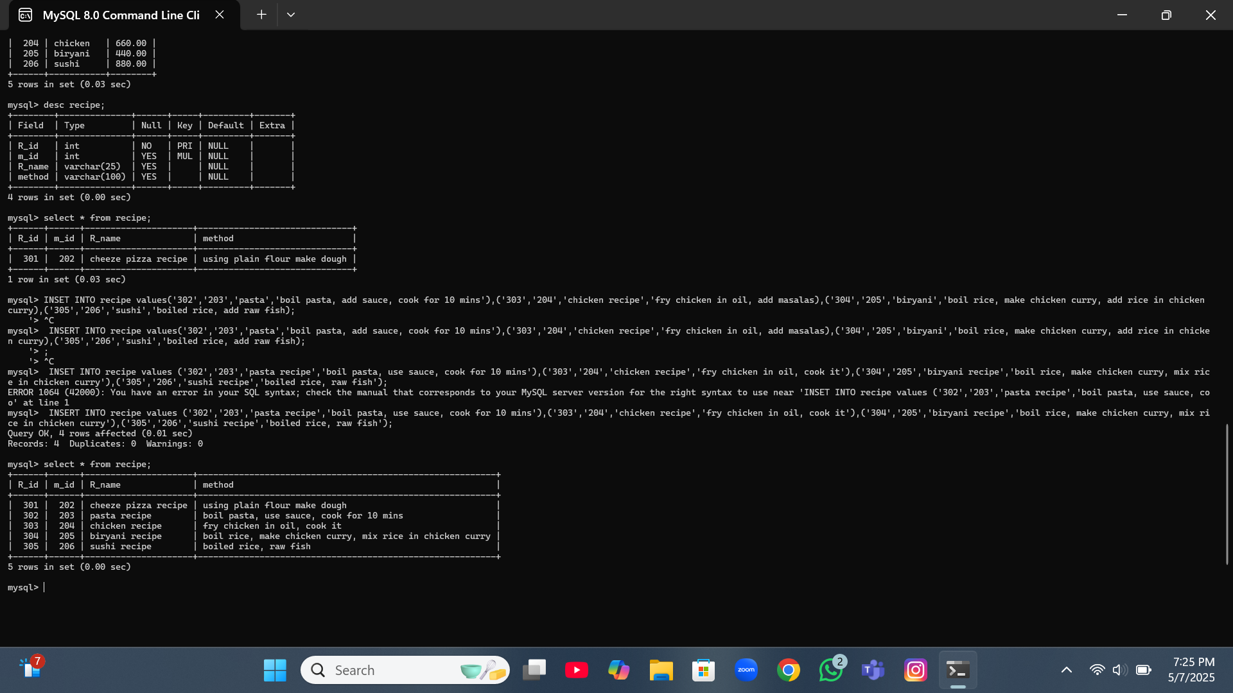

Slide 19
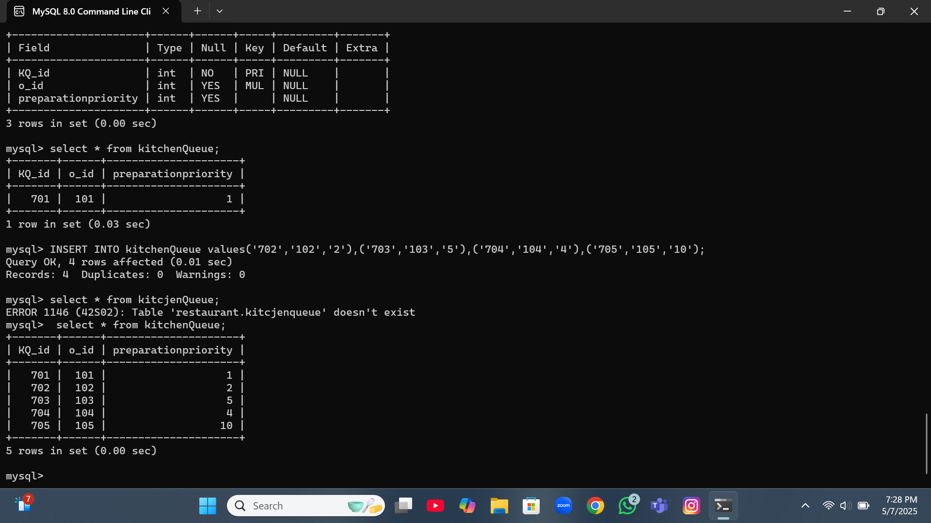

Slide 20
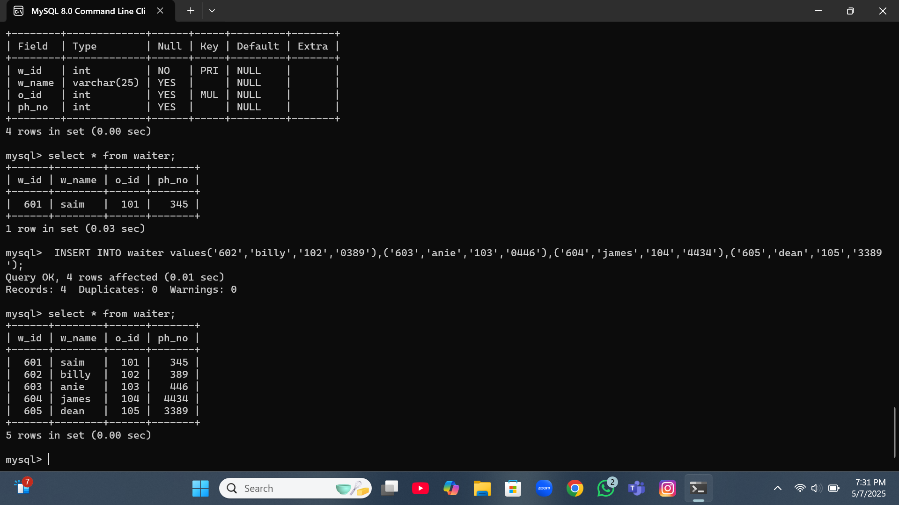

Slide 21
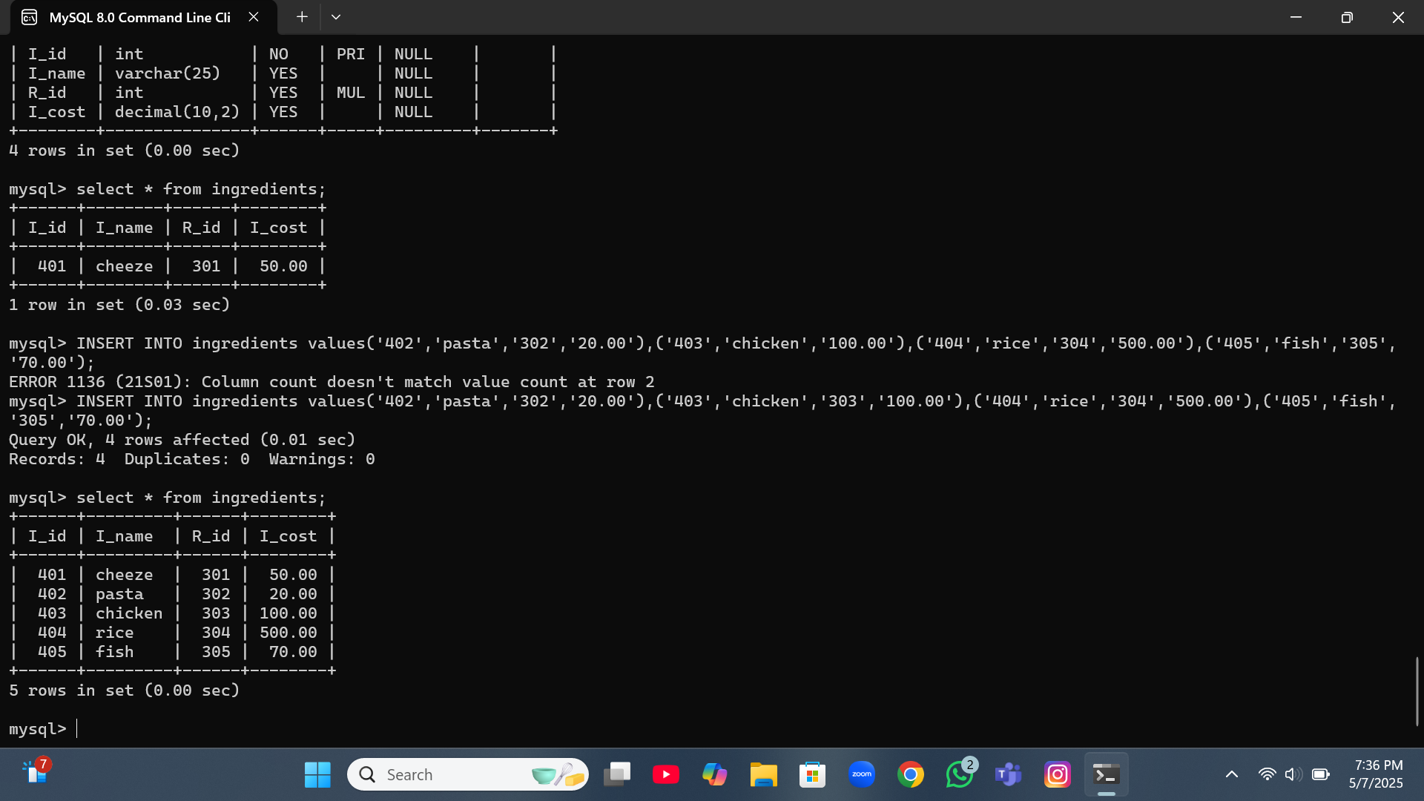

Slide 22
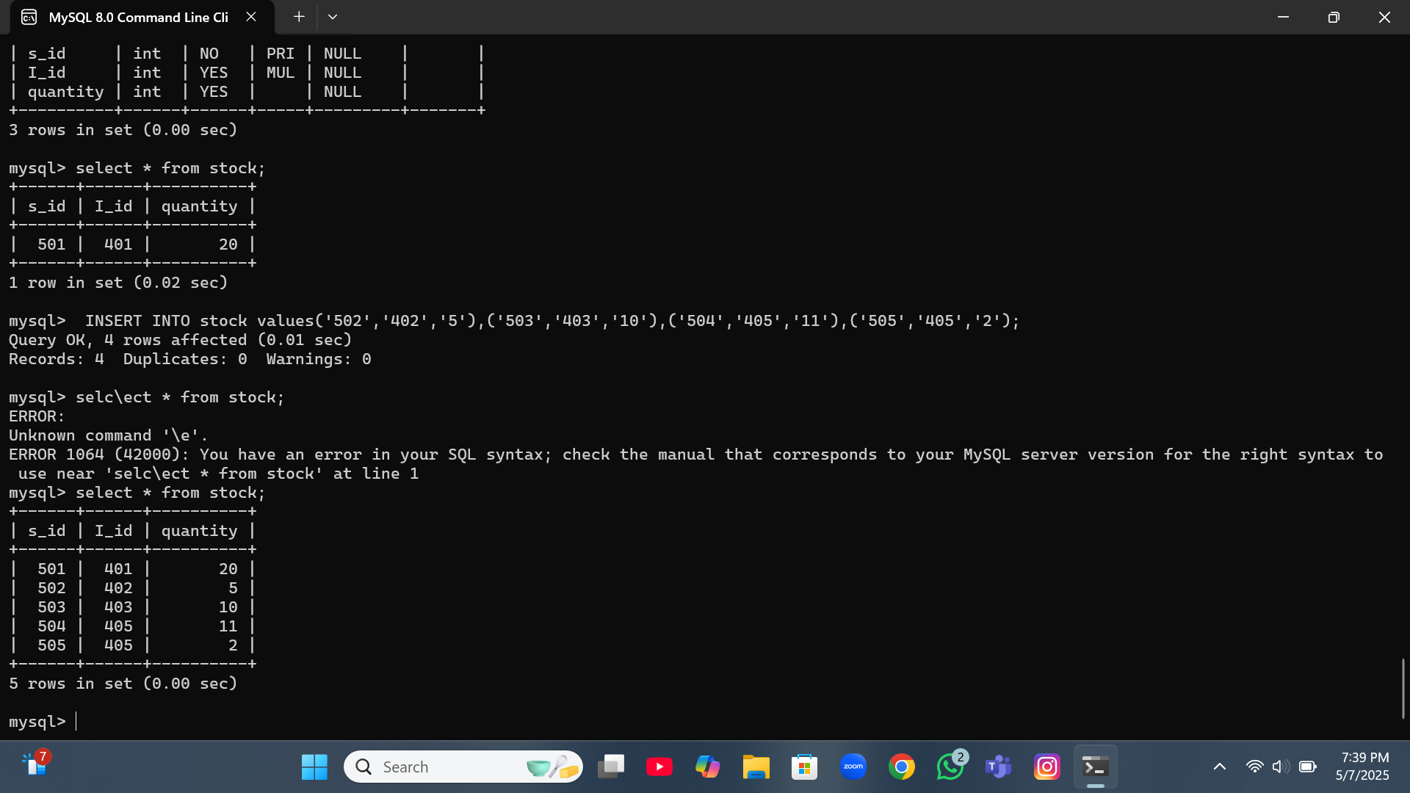

Slide 23
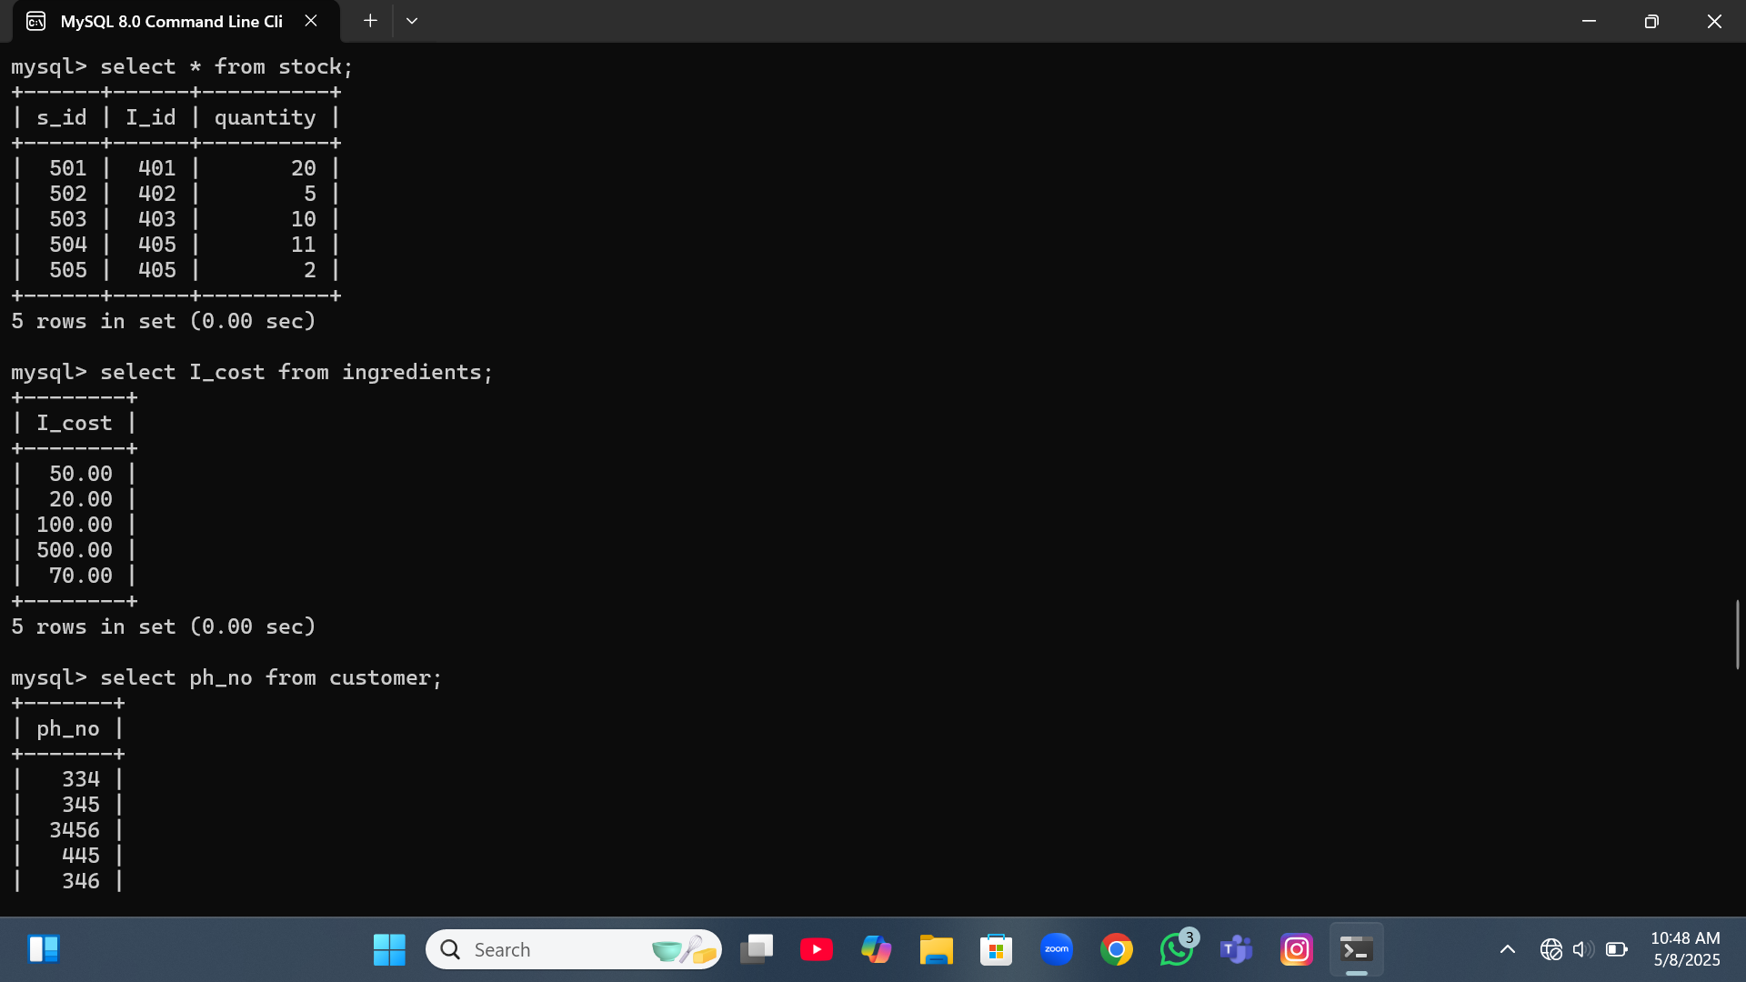

Slide 24
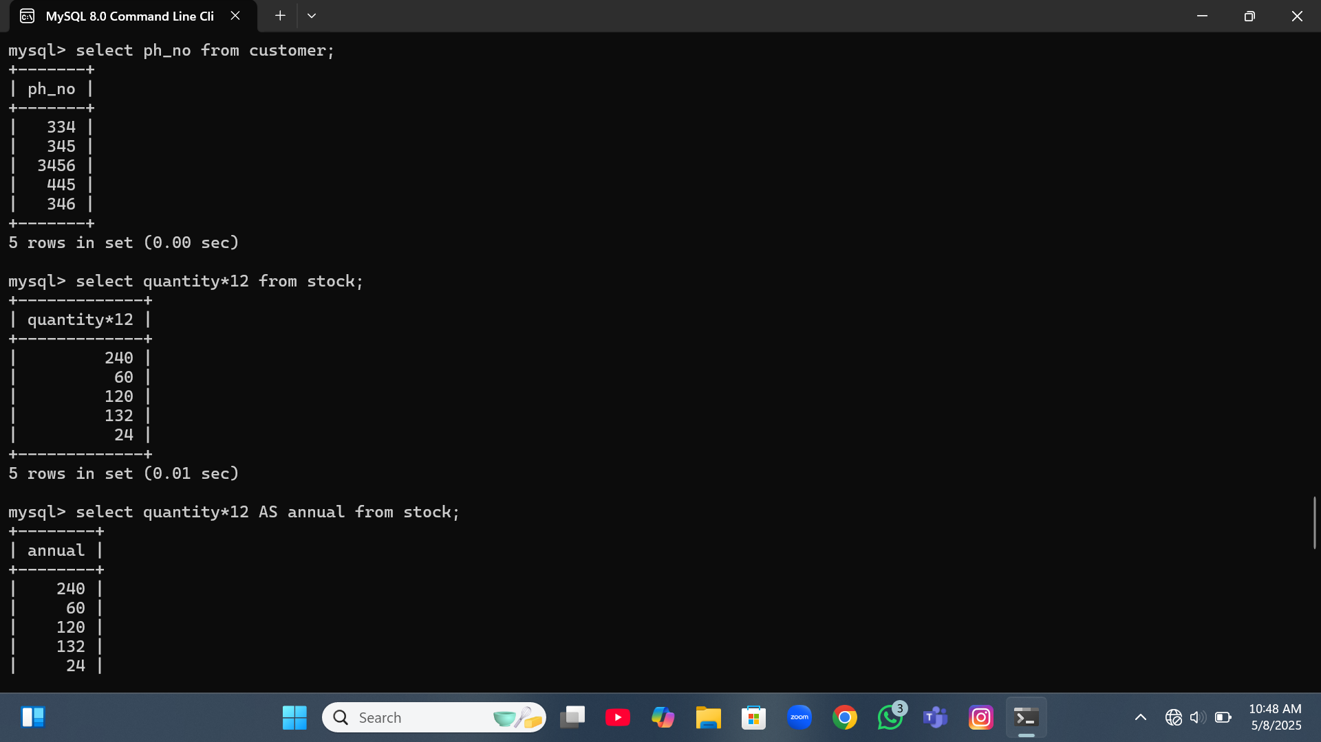

Slide 25
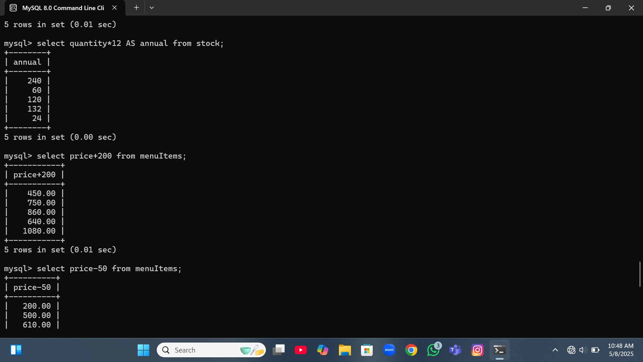

Slide 26
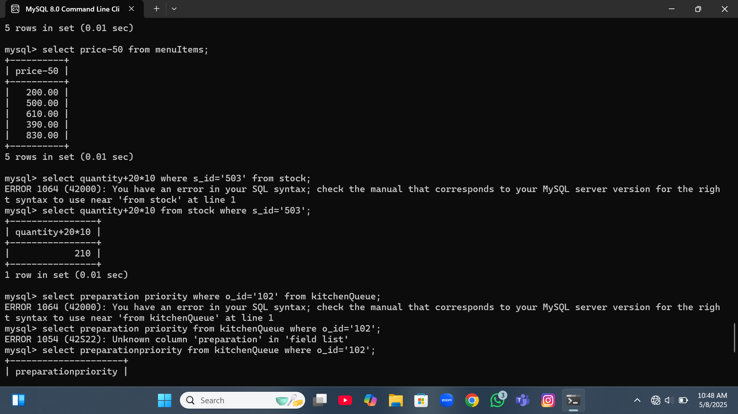

Slide 27
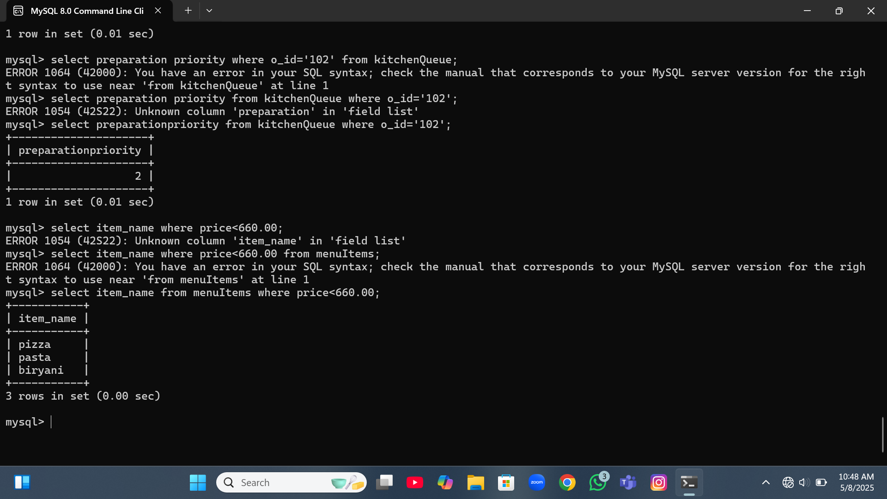

Slide 28
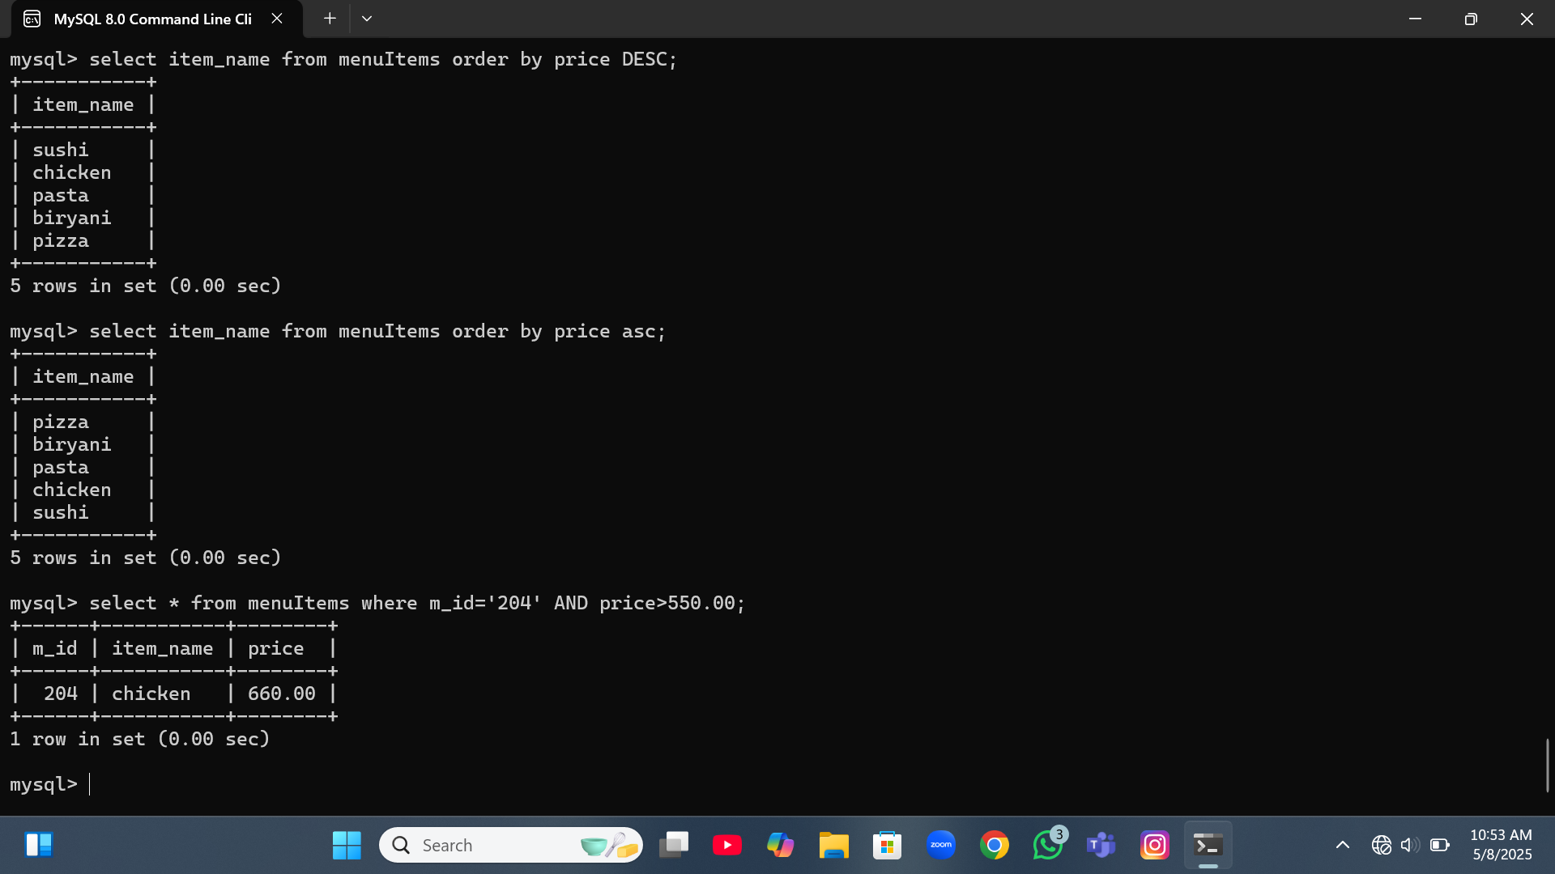

Slide 29
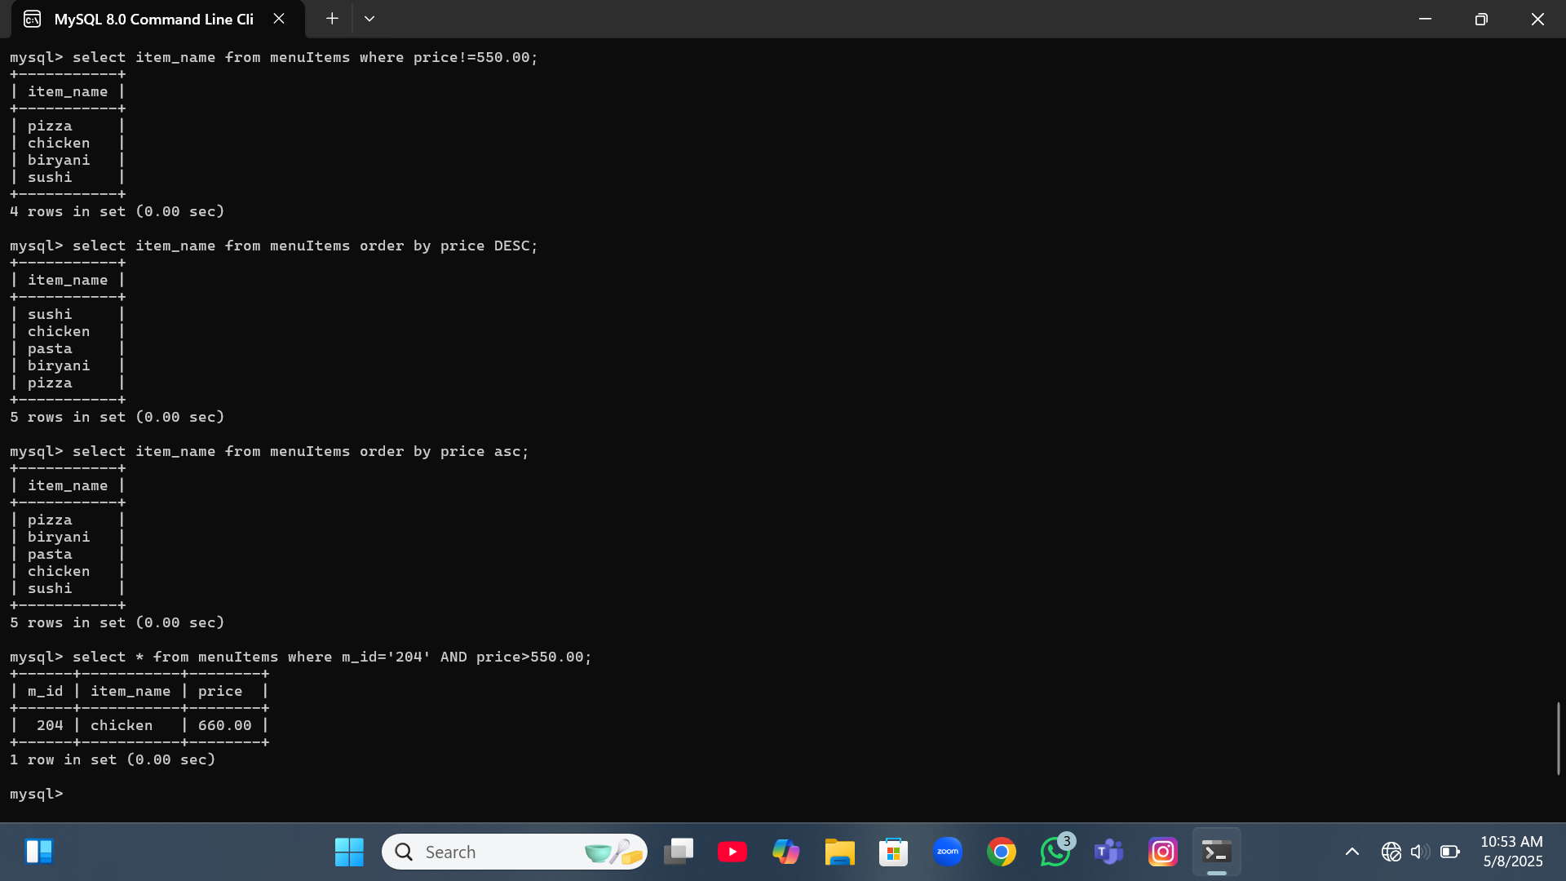

Slide 30
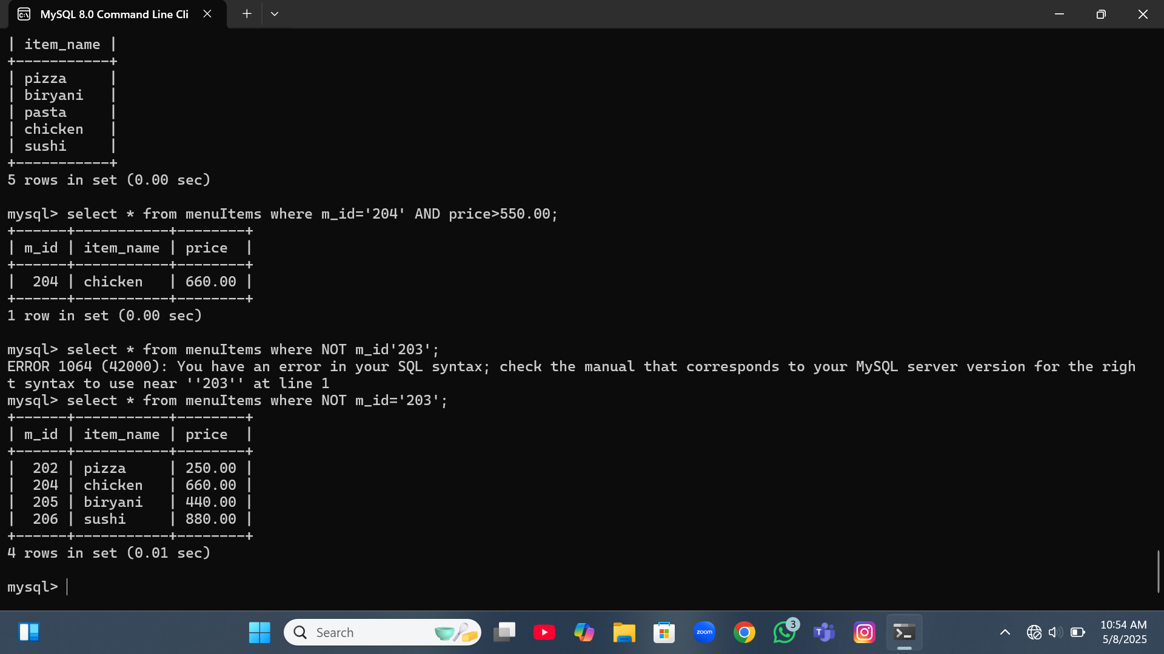

Slide 31
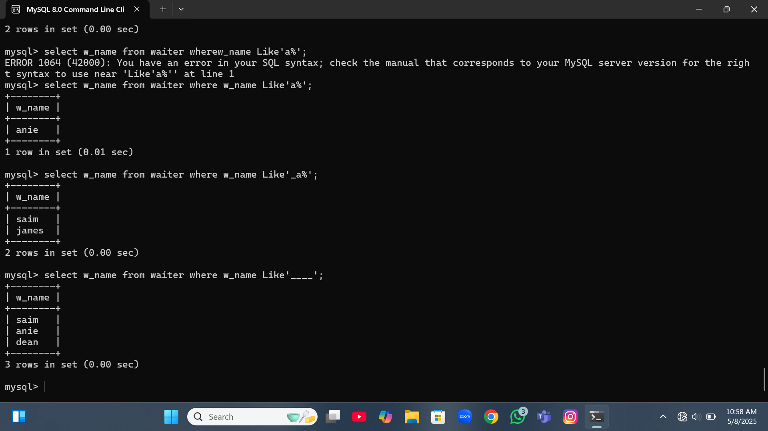

Slide 32
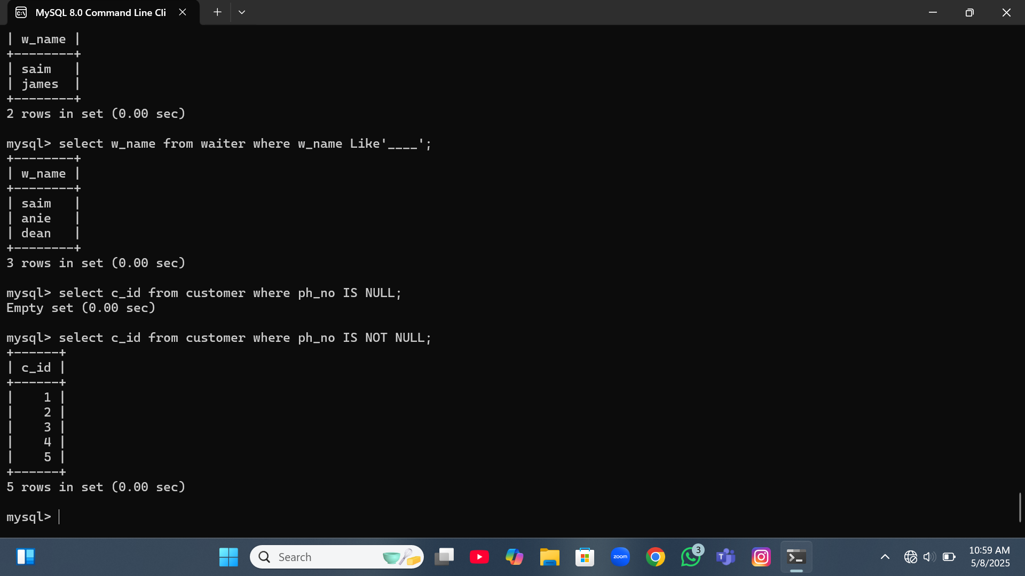

Slide 33
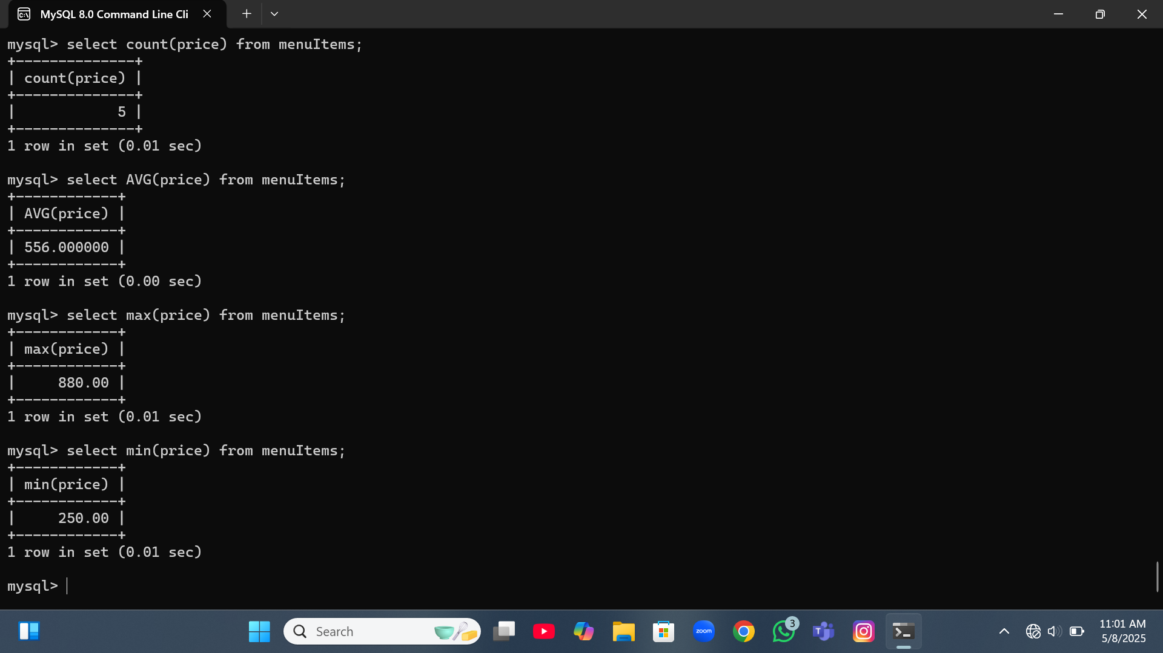

Slide 34
